Slide 1
Simple Glass-Marketing Basic Template
Here is where your presentation begins

Slide 2
Contents of this template
You can delete this slide when you’re done editing the presentation
Fonts | To view this template correctly in PowerPoint, download and install the fonts we used
Used and alternative resources | An assortment of graphic resources that are suitable for use in this presentation
Thanks slide | You must keep it so that proper credits for our design are given
Colors | All the colors used in this presentation
Icons and infographic resources | These can be used in the template, and their size and color can be edited
Editable presentation theme | You can edit the master slides easily. For more info, click here
For more info: SLIDESGO | BLOG | FAQs
You can visit our sister projects: FREEPIK | FLATICON | STORYSET | WEPIK | VIDEVO

Slide 3
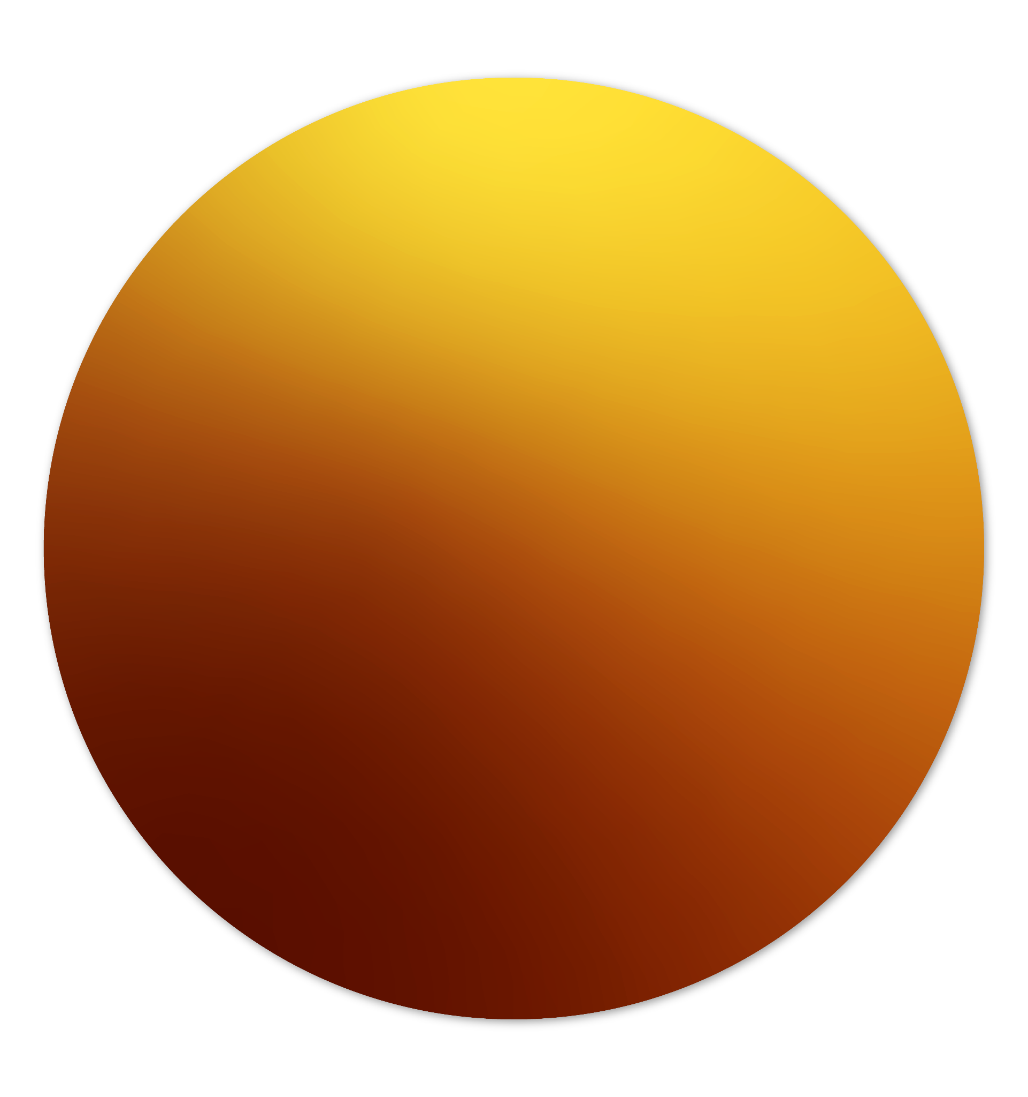
Table of contents
01
02
03
About us
Marketing
Resources
Jupiter is a gas giant and the biggest planet in the Solar System. It's the fourth-brightest object in the night sky. It was named after the Roman god of the skies
Venus has a beautiful name and is the second planet from the Sun. It’s terribly hot and its atmosphere is poisonous. It’s the second-brightest natural object in the night sky
Saturn is a gas giant and has several rings. It's composed mostly of hydrogen and helium. Saturn was named after the Roman god of wealth and agriculture

Slide 4
01
About us
You can enter a subtitle here if you need it

Slide 5
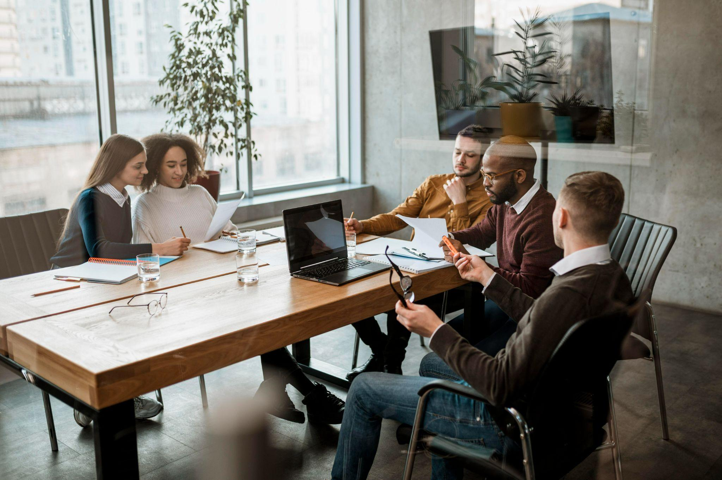
About us
Mercury is the closest planet to the Sun and the smallest one in the entire Solar System. This planet's name has nothing to do with the liquid metal, since Mercury was named after the Roman messenger god. Despite being closer to the Sun than Venus, its temperatures aren't as terribly hot as that planet's. Its surface is quite similar to that of Earth's Moon, which means there are a lot of craters and plains
Speaking of craters, many of them were named after artists or authors who made significant contributions to their respective fields. Mercury takes a little more than 58 days to complete its rotation, so try to imagine how long days must be there! Since the temperatures are so extreme, albeit not as extreme as in Venus, and the solar radiation is so high, Mercury has been deemed to be non-habitable for humans

Slide 6
—Someone Famous
“This is a quote, words full of wisdom that someone important said and can make the reader get inspired.”

Slide 7
Factory features
Jupiter
Venus
Jupiter is a gas giant and the biggest planet in the Solar System. It's the fourth-brightest object in the night sky. It was named after the Roman god of the skies and lightning
Despite being red, Mars is actually a cold place. It's full of iron oxide dust, which gives Mars its reddish cast
Venus has a beautiful name and is the second planet from the Sun. It’s terribly hot, even hotter than Mercury, and its atmosphere is extremely poisonous. It’s the second-brightest natural object in the night sky after the Moon
Mercury is the closest planet to the Sun and the smallest one of them all

Slide 8
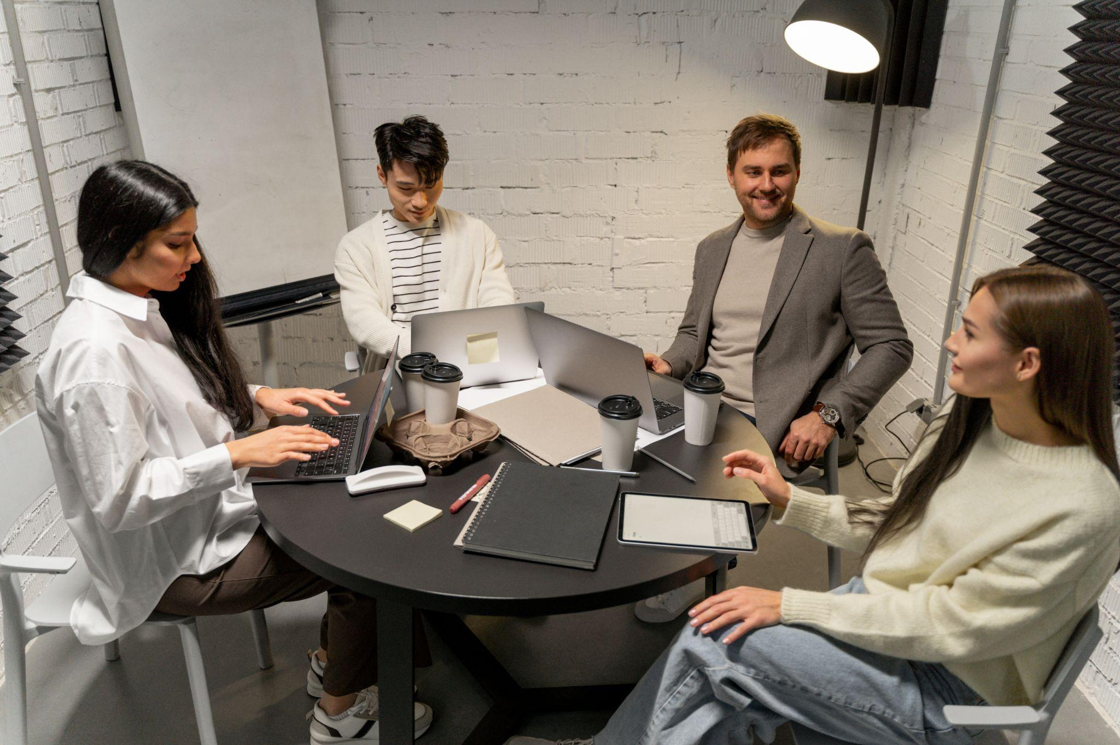
Important points
Venus has a beautiful name and is the second planet from the Sun. It’s terribly hot, even hotter than Mercury, and its atmosphere is extremely poisonous. It’s the second-brightest natural object in the night sky after the Moon
Earth is the third planet from the Sun and the only one that harbors life in the Solar System. This is where we all live
Jupiter is a gas giant and the biggest planet in the Solar System. It's the fourth-brightest object in the night sky. It was named after the Roman god of the skies and lightning
Mercury is the smallest planet in the Solar System. It was named after the Roman messenger god

Slide 9
The growth over the years
+20%
2015
+70%
2020
Venus is the second planet from the Sun
Despite being red, Mars is a extremely cold place
+50%
2018
+80%
2023
Mercury is the smallest planet in the Solar System
Jupiter is the biggest planet in the Solar System

Slide 10
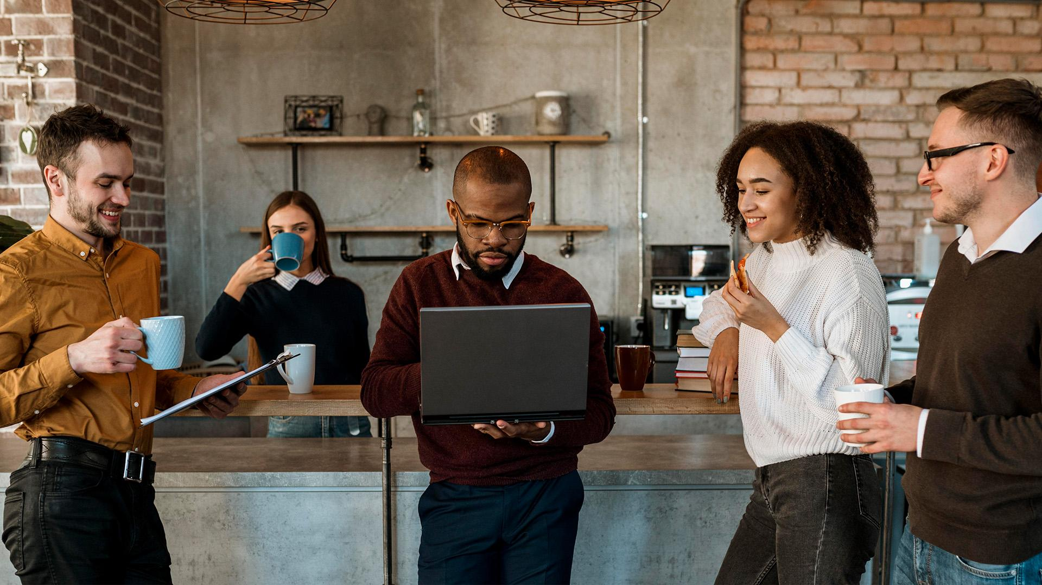
A picture is worth a thousand words

Slide 11
Our beginnings
Mercury is the closest planet to the Sun and the smallest of them all. This planet's name has nothing to do with the liquid metal, since Mercury was named after the Roman messenger god. Despite being closer to the Sun than Venus, its temperatures aren't as terribly hot as that planet's. Its surface is quite similar to that of Earth's Moon, which means there are a lot of craters and plains. Speaking of craters, many of them were named after artists or authors who made significant contributions to their respective fields. Mercury takes a little more than 58 days to complete its rotation, so try to imagine how long days must be there! Since the temperatures are so extreme, albeit not as extreme as in Venus
Mercury is the closest planet to the Sun and the smallest of them all. This planet's name has nothing to do with the liquid metal, since Mercury was named after the Roman messenger god. Despite being closer to the Sun than Venus, its temperatures aren't as terribly hot as that planet's. Its surface is quite similar to that of Earth's Moon, which means there are a lot of craters and plains. Speaking of craters, many of them were named after artists or authors who made significant contributions to their respective fields. Mercury takes a little more than 58 days to complete its rotation, so try to imagine how long days must be there! Since the temperatures are so extreme, albeit not as extreme as in Venus

Slide 12
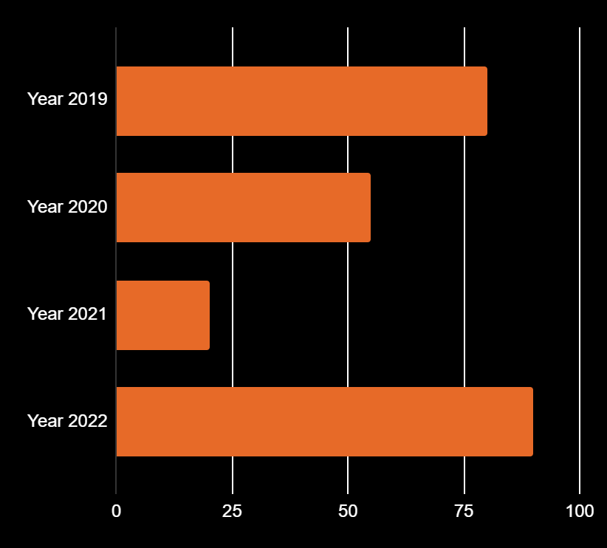
You can use this graph
2019
2020
+80%
+55%
2021
2022
+20%
+90%
Mercury is the smallest planet of them all
Venus is the second planet from the Sun
Jupiter is the biggest planet of them all
Saturn is a gas giant and has several rings
Follow the link in the graph to modify its data and then paste the new one here. For more info, click here

Slide 13
Thanks!
Do you have any questions?
youremail@freepik.com
+34 654 321 432
yourwebsite.com
Please keep this slide for attribution

Slide 14
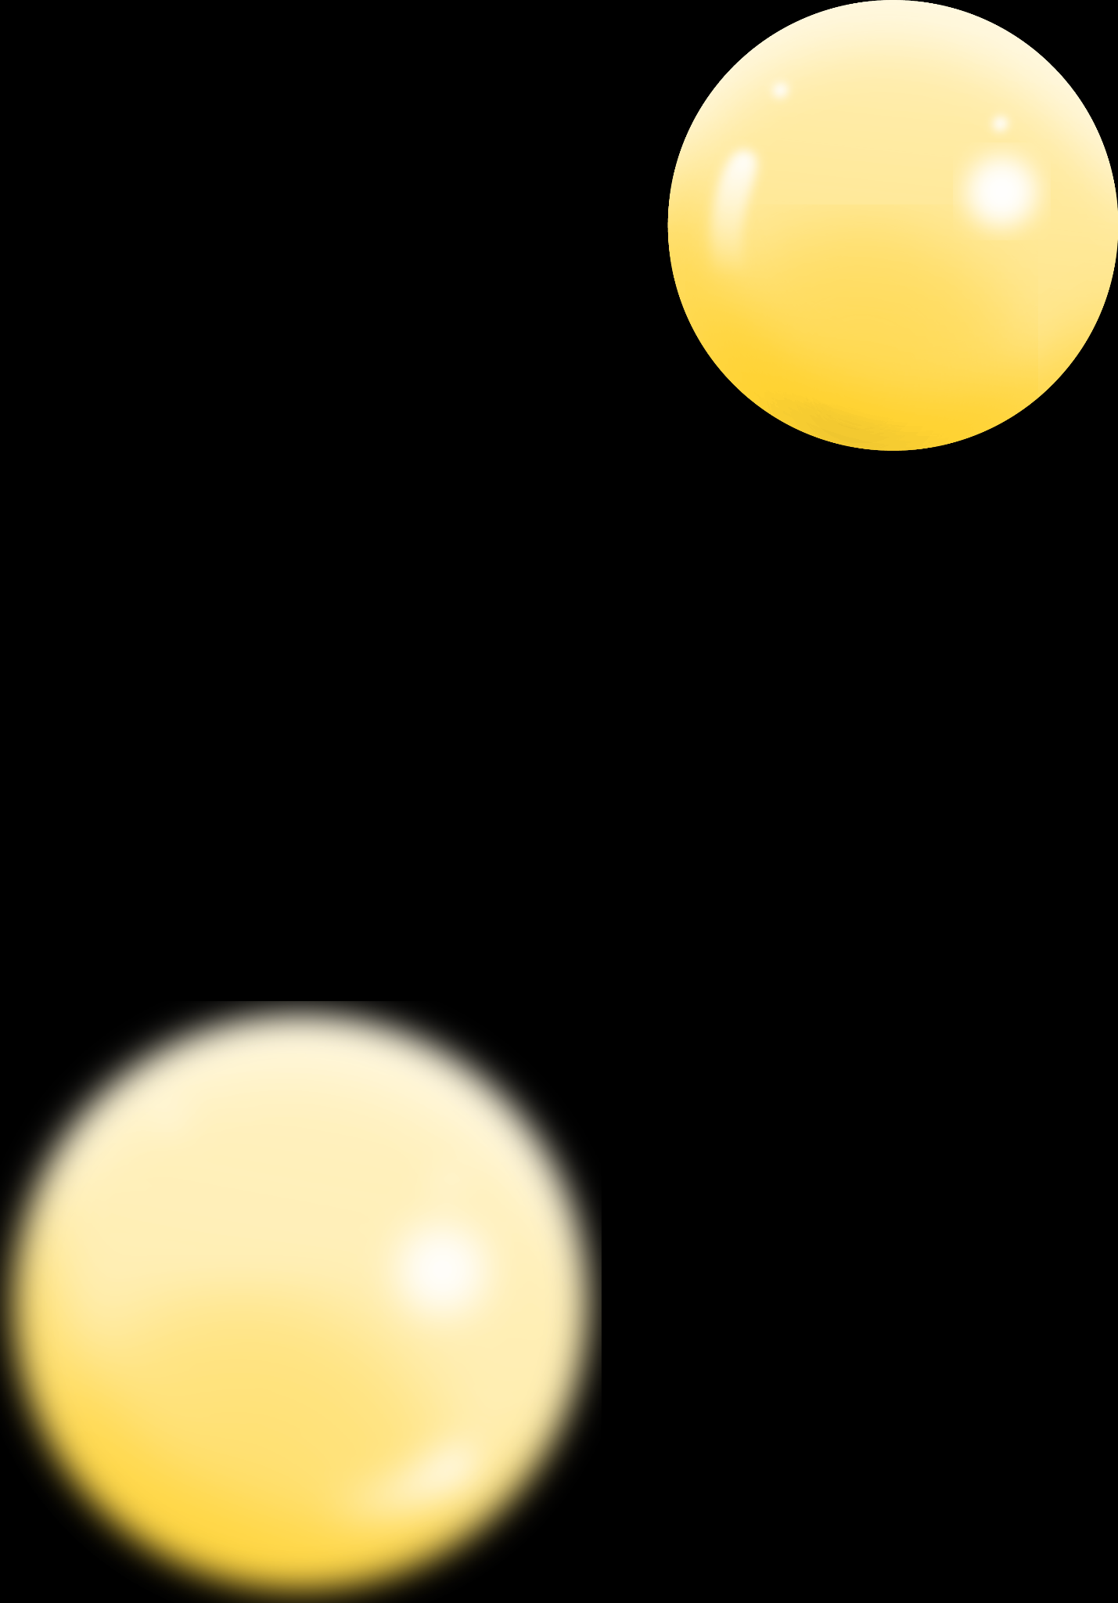
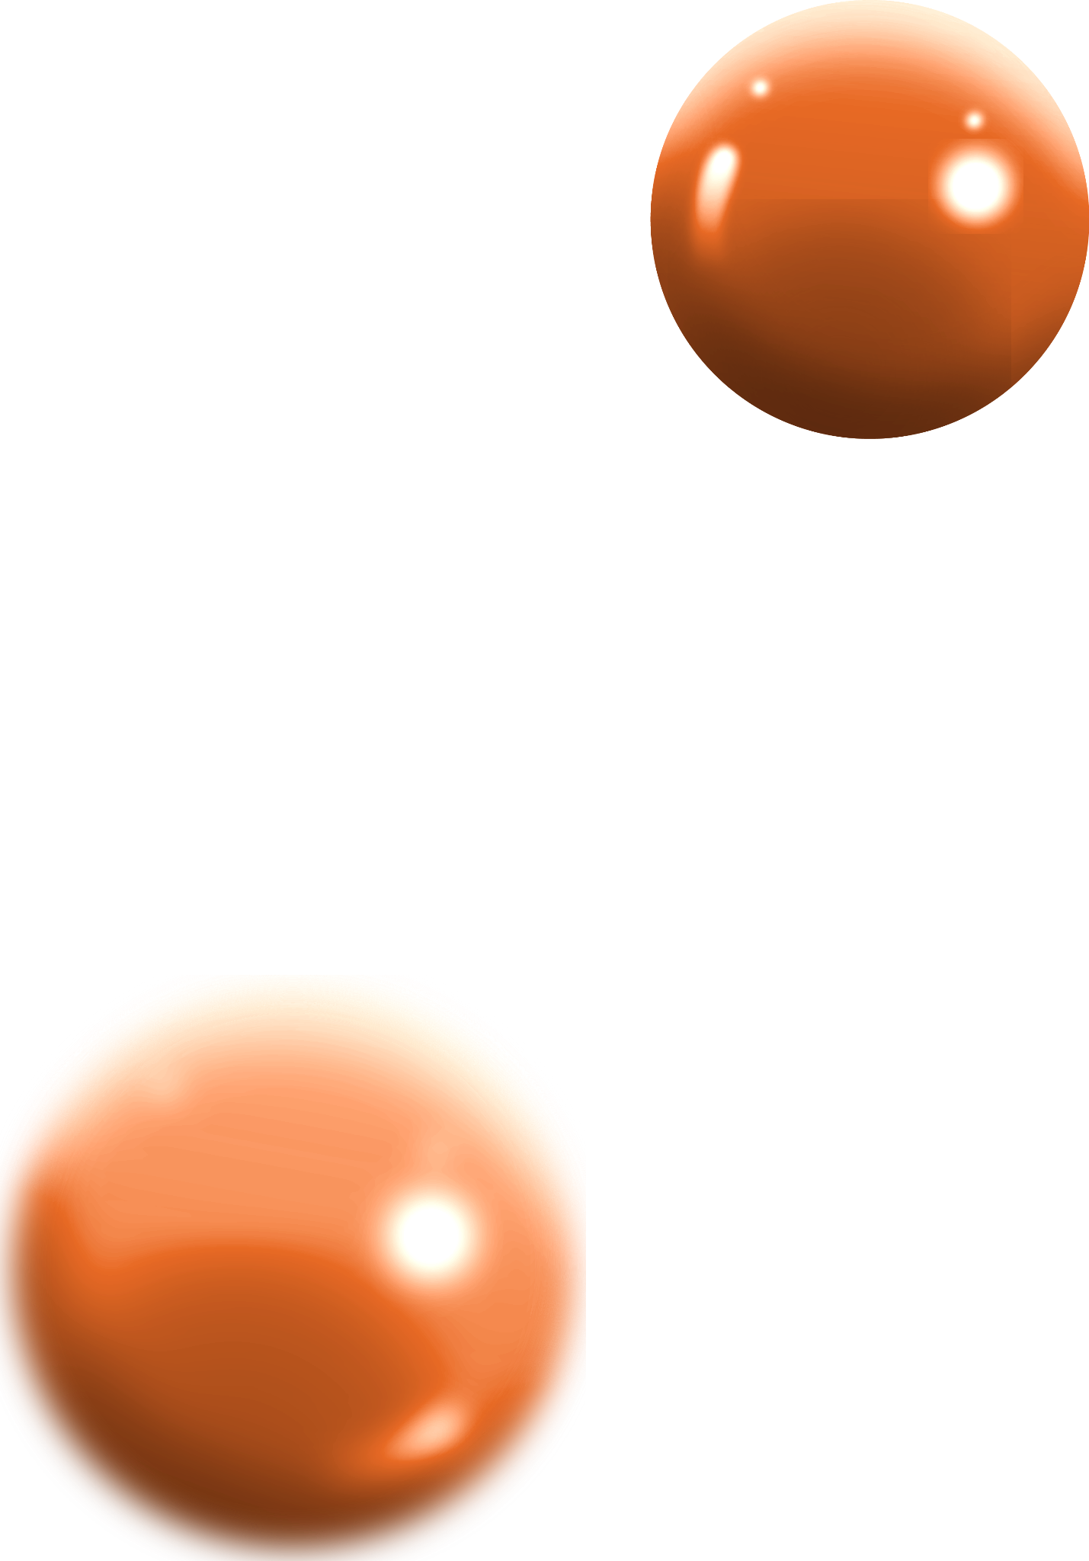
Alternative resources
Here’s an assortment of alternative resources whose style fits the one of this template:
Vectors:
Glossy flowing spheres background

Slide 15
Resources
Did you like the resources on this template? Get them for free at our other websites:
Photos:
Business owner working on their strategy
Front view of people having a meeting in the office
Front view of people meeting over a cup of coffee
Vectors:
Isometric glass effect credit card

Slide 16
Instructions for use
If you have a free account, in order to use this template, you must credit Slidesgo by keeping the Thanks slide. Please refer to the next slide to read the instructions for premium users.
As a Free user, you are allowed to:
Modify this template.
Use it for both personal and commercial projects.
You are not allowed to:
Sublicense, sell or rent any of Slidesgo Content (or a modified version of Slidesgo Content).
Distribute Slidesgo Content unless it has been expressly authorized by Slidesgo.
Include Slidesgo Content in an online or offline database or file.
Offer Slidesgo templates (or modified versions of Slidesgo templates) for download.
Acquire the copyright of Slidesgo Content.
For more information about editing slides, please read our FAQs or visit our blog:
https://slidesgo.com/faqs and https://slidesgo.com/slidesgo-school

Slide 17
Instructions for use (premium users)
As a Premium user, you can use this template without attributing Slidesgo or keeping the "Thanks" slide.
You are allowed to:
Modify this template.
Use it for both personal and commercial purposes.
Hide or delete the “Thanks” slide and the mention to Slidesgo in the credits.
Share this template in an editable format with people who are not part of your team.
You are not allowed to:
Sublicense, sell or rent this Slidesgo Template (or a modified version of this Slidesgo Template).
Distribute this Slidesgo Template (or a modified version of this Slidesgo Template) or include it in a database or in any other product or service that offers downloadable images, icons or presentations that may be subject to distribution or resale.
Use any of the elements that are part of this Slidesgo Template in an isolated and separated way from this Template.
Register any of the elements that are part of this template as a trademark or logo, or register it as a work in an intellectual property registry or similar.
For more information about editing slides, please read our FAQs or visit our blog:
https://slidesgo.com/faqs and https://slidesgo.com/slidesgo-school

Slide 18
Fonts & colors used
This presentation has been made using the following fonts:
Manrope Extrabold
(https://fonts.google.com/specimen/Manrope)
Albert Sans
(https://fonts.google.com/specimen/Albert+Sans)
#000000
#ffffff
#e76a28
#ffc800

Slide 19

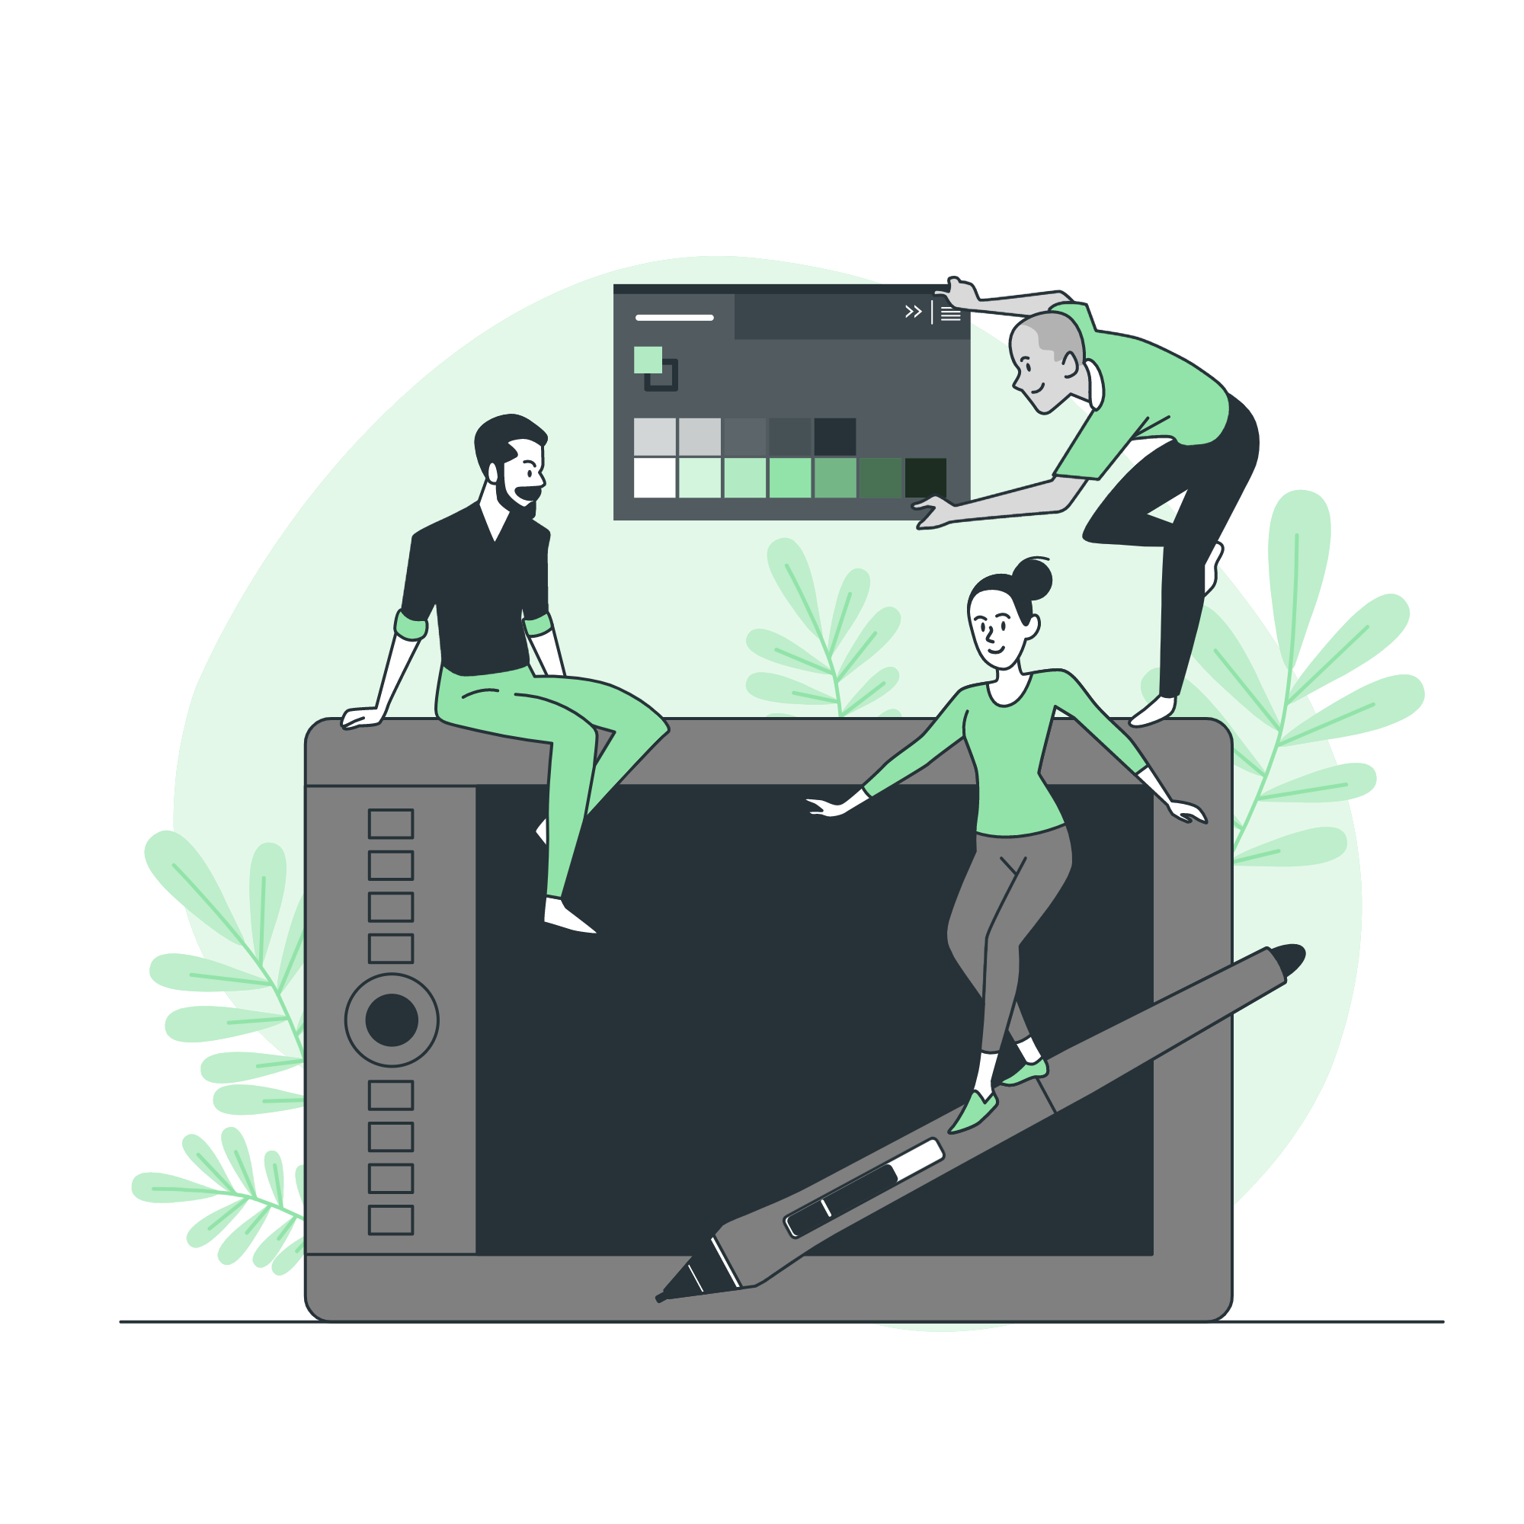

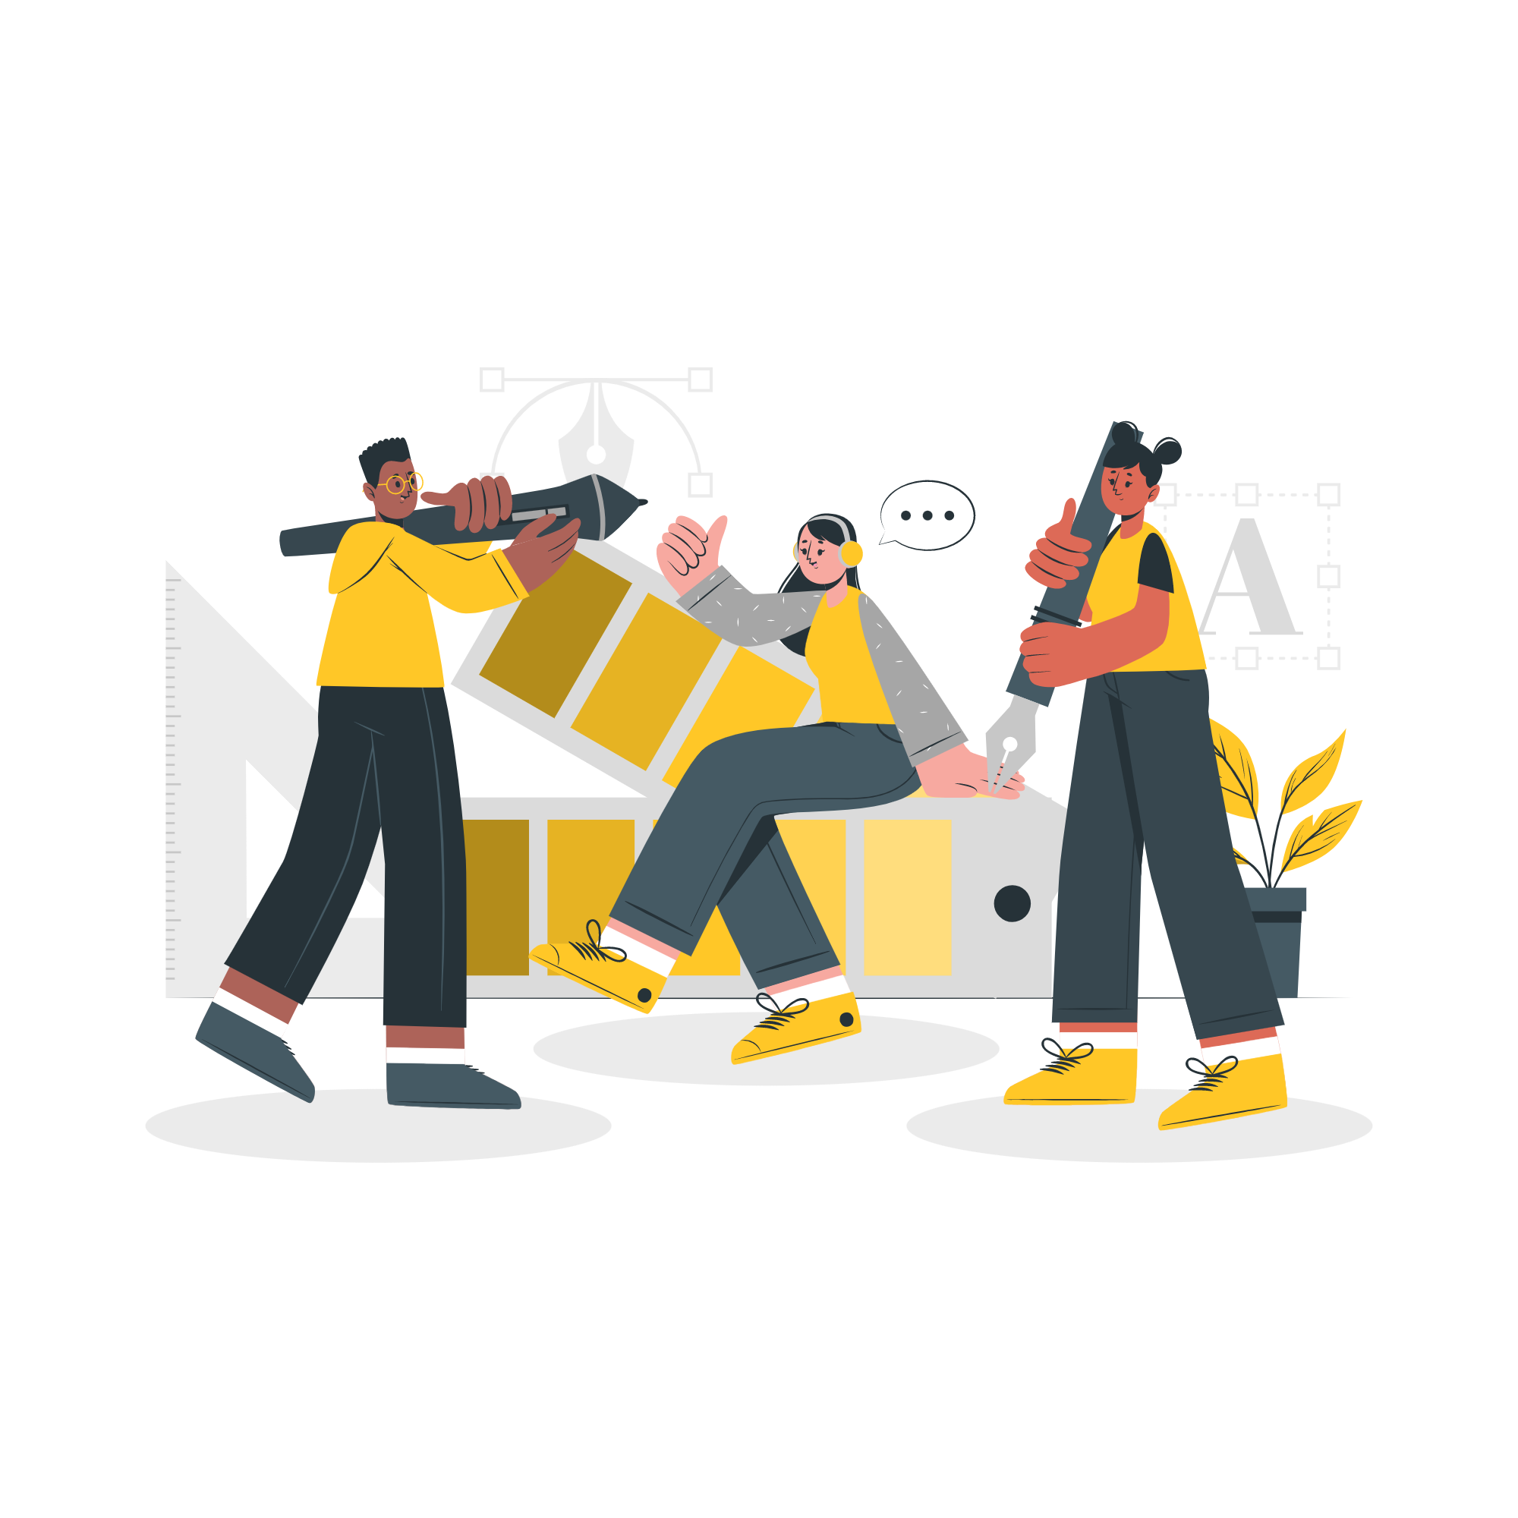

Storyset
Create your Story with our illustrated concepts. Choose the style you like the most, edit its colors, pick the background and layers you want to show and bring them to life with the animator panel! It will boost your presentation. Check out how it works.
Pana
Amico
Bro
Rafiki
Cuate

Slide 20
Use our editable graphic resources...
You can easily resize these resources without losing quality. To change the color, just ungroup the resource and click on the object you want to change. Then, click on the paint bucket and select the color you want. Group the resource again when you’re done. You can also look for more infographics on Slidesgo.

Slide 23
JANUARY
FEBRUARY
MARCH
APRIL
MAY
JUNE
PHASE 1
Task 1
Task 2
PHASE 2
Task 1
Task 2
JANUARY
FEBRUARY
MARCH
APRIL
PHASE 1
Task 1
Task 2

Slide 26
...and our sets of editable icons
You can resize these icons without losing quality.
You can change the stroke and fill color; just select the icon and click on the paint bucket/pen.
In Google Slides, you can also use Flaticon’s extension, allowing you to customize and add even more icons.

Slide 27
Educational Icons
Medical Icons

Slide 28
Business Icons
Teamwork Icons

Slide 29
Help & Support Icons
Avatar Icons

Slide 30
Creative Process Icons
Performing Arts Icons

Slide 31
Nature Icons

Slide 32
SEO & Marketing Icons

Slide 33


